Slide 1
Metabolic Diseases Lesson 2.5
Disorders of metabolism – where do things go wrong?

Slide 2
Do Now
A person with diabetes eats macaroni and cheese - what happens?

Slide 3
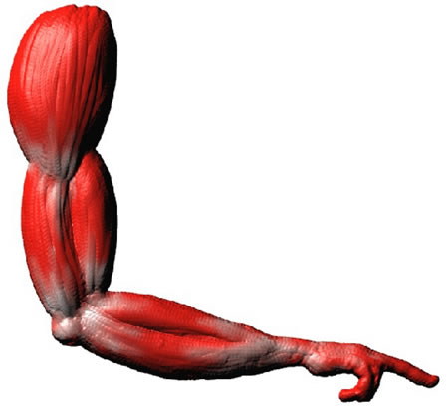
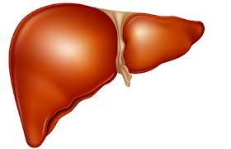
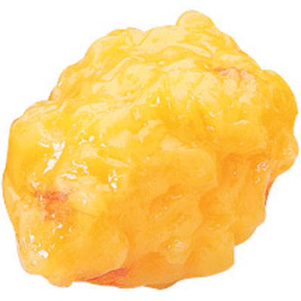
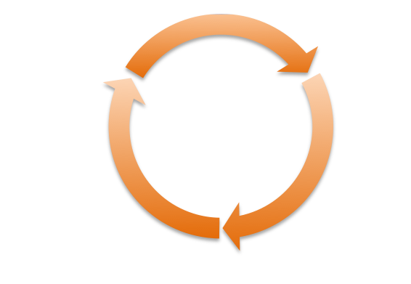
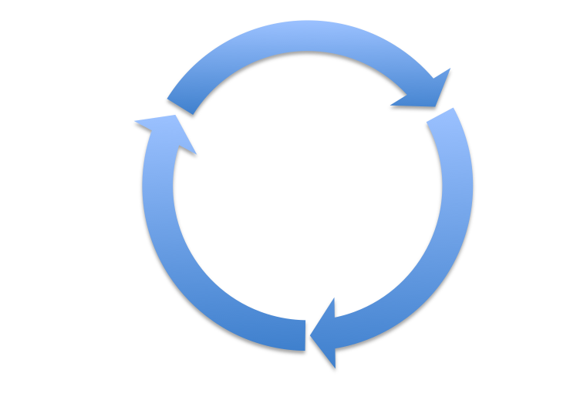
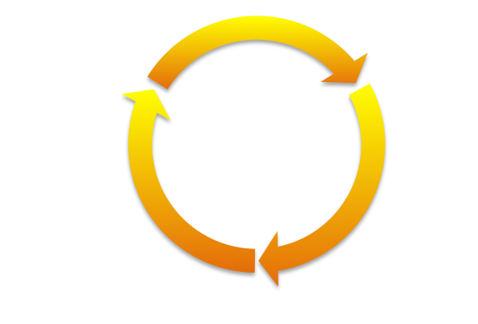
A person with diabetes eats macaroni and cheese – what happens?
Glycogen
Glucose
Glucose
Triglyceride
Adipose
Protein
Glycogen
Acetyl CoA
Lipogenesis
Citric Acid
Cycle
Amino Acids
Lipolysis

Slide 4
Hormones tell our organs what to do: Insulin and Glucagon
Notes:
6:05 minutes

Slide 5
Activity
What happens when metabolic pathways don’t work normally?
Divide into groups with six students each. Each student will read a short case and answer questions on the worksheet.
Be prepared to share your answers with the rest of your group.

Slide 6
Wrap Up
Diabetes is far more common than the other diseases in the activity. Why do you think this is?
What is a common treatment for each of the diseases? Why does this treatment work?

Slide 7
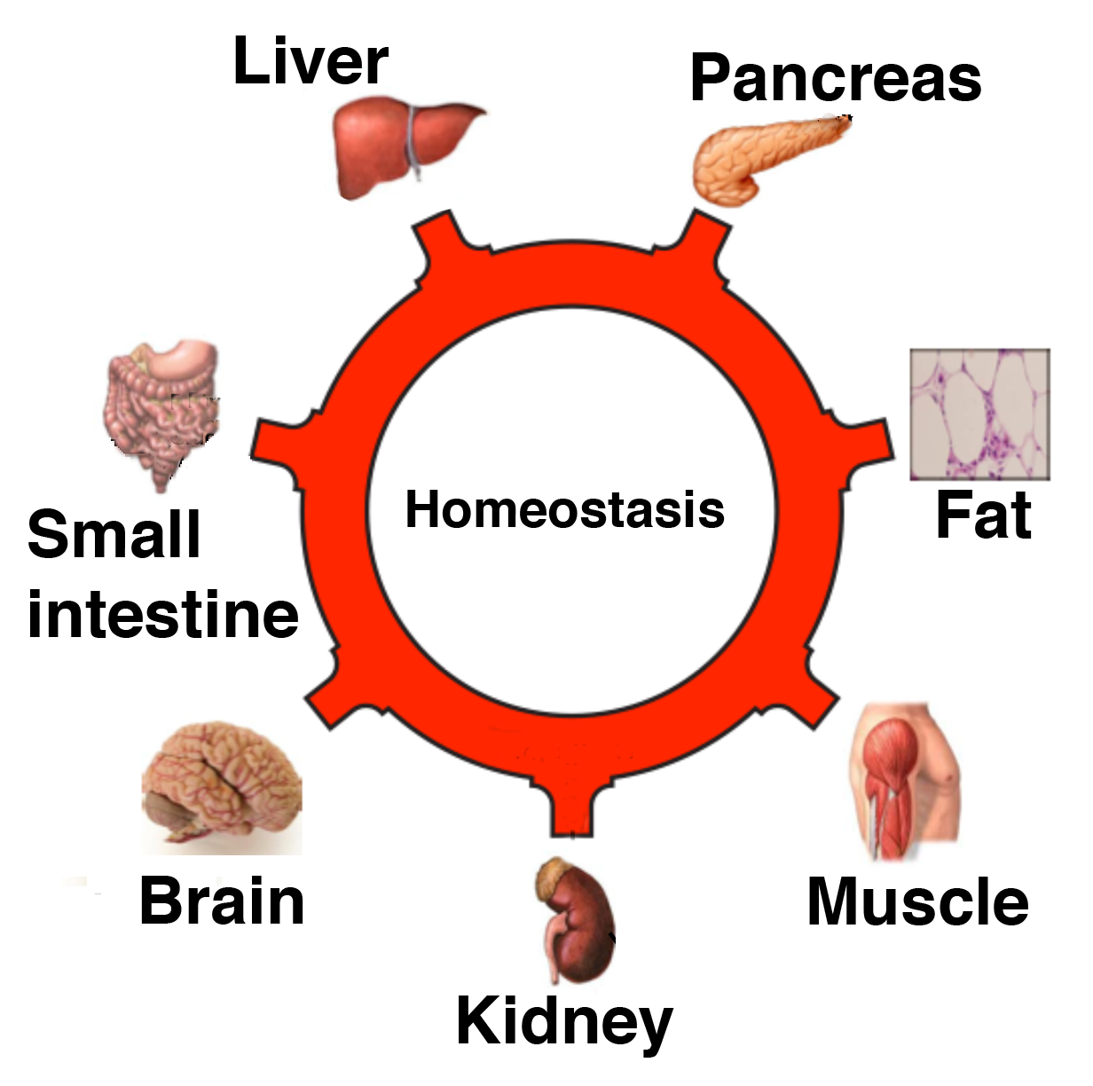
Homework
Complete the homework sheet which reviews organ function in glucose homeostasis, and considers how different situations impact homeostasis.

